Slide 1
Performance Anomaly Detection at Scale
Tuli Nivas
October 2, 2018

Slide 2
Finding Performance Improvements/Degradations
𝛿
Change made
Source: https://github.com/salesforce/Argus
Notes:
change made for a bug fix that you know affects CPU usage
Need to find if there was an actual perf improvement/degradation
Download the raw data and calculate the summary - easy enough to do

Slide 3
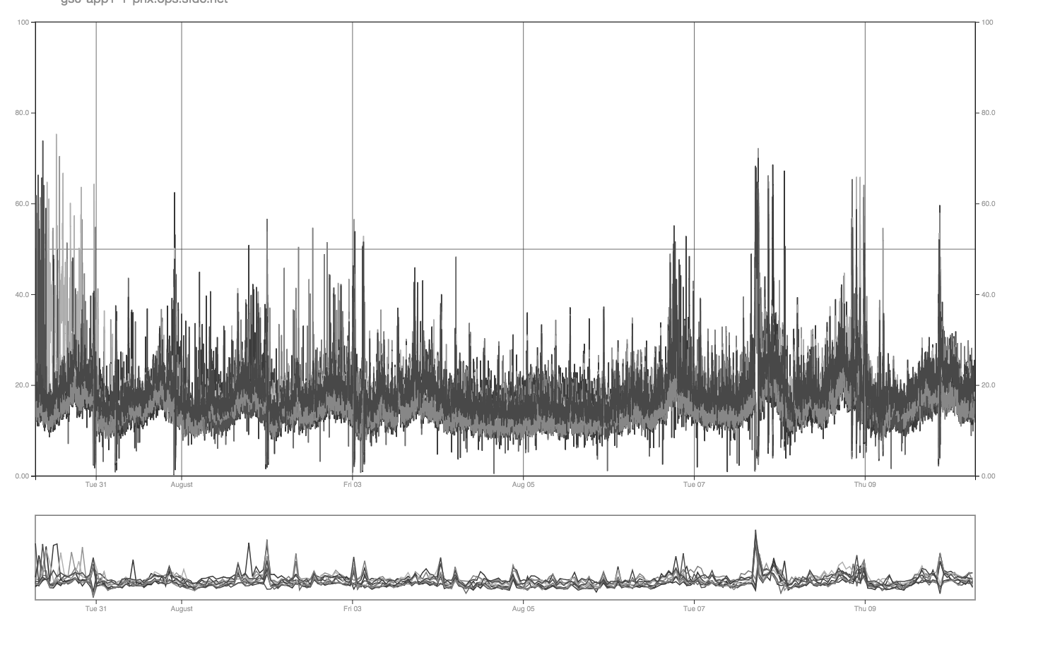
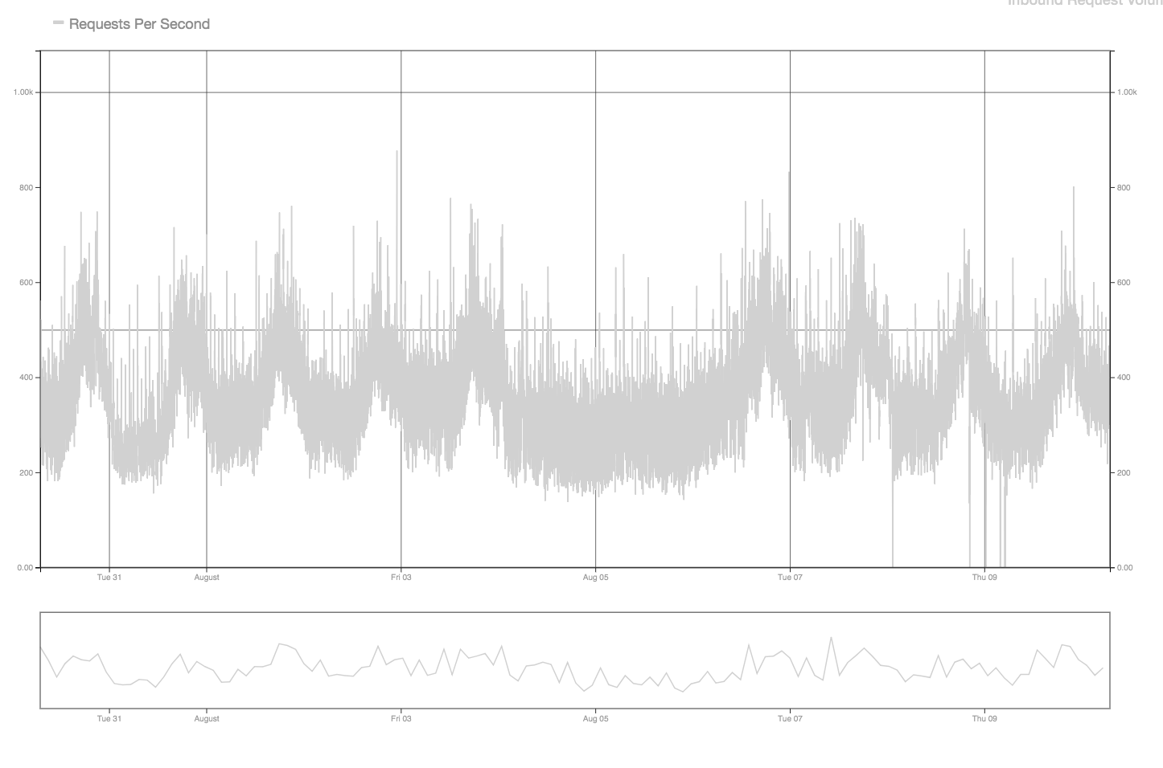
Finding Performance Improvements/Degradations
Source: https://github.com/salesforce/Argus
Notes:
When identifying degradations - things become a little more complicated
CPU spikes? Perf degradation?
Requests/load looks to be the same - so now what are some of the other metrics that could affect CPU?

Slide 4
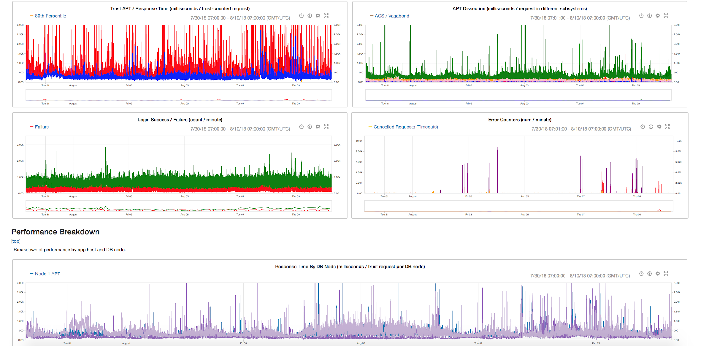
Finding Performance Improvements/Degradations
Source: https://github.com/salesforce/Argus
Notes:
Now this is tedious work - looking at tens of metrics and then trying to eyeball if any one of them could be causing the CPU increase
And come to think of it this is just one pod. What happens when there are hundreds of pods?

Slide 5
Development/Release Lifecycle
Development
Design
Testing
Release
Analysis
Notes:
Simplistic view of the development/release lifecycle
Which basically implies that we are continuously trying to compare new code with the old → always looking for improvements
which in turn implies that we have our training/testing data set

Slide 6
Proposed Solution for Anomaly Detection
Number of Incoming Transactions
CPU Utilization
Log Counts
Log Volume
3 Types of Errors
Garbage Collection Counts
Garbage Collection Times
Conditions
Run Daily (Real Time)
Compare Release over Release Performance
Challenges
Verify Load Profile
Data Correlation

Slide 7
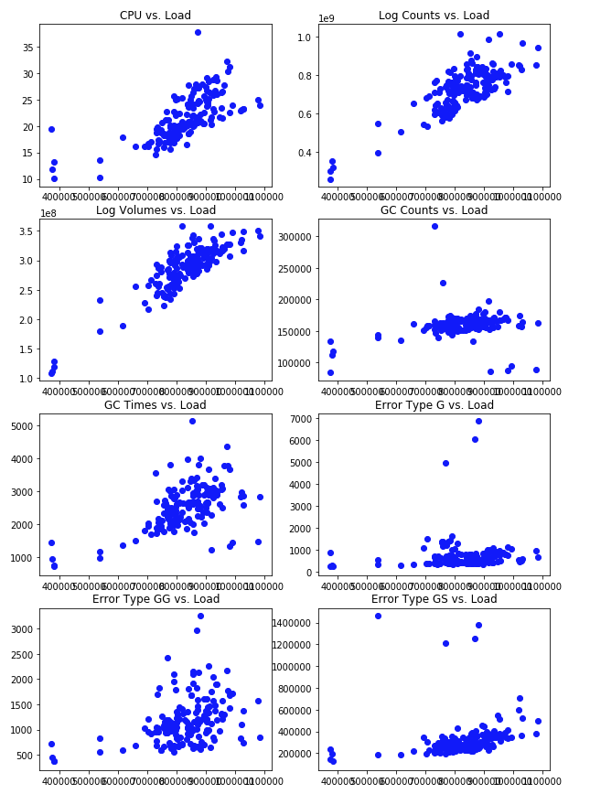
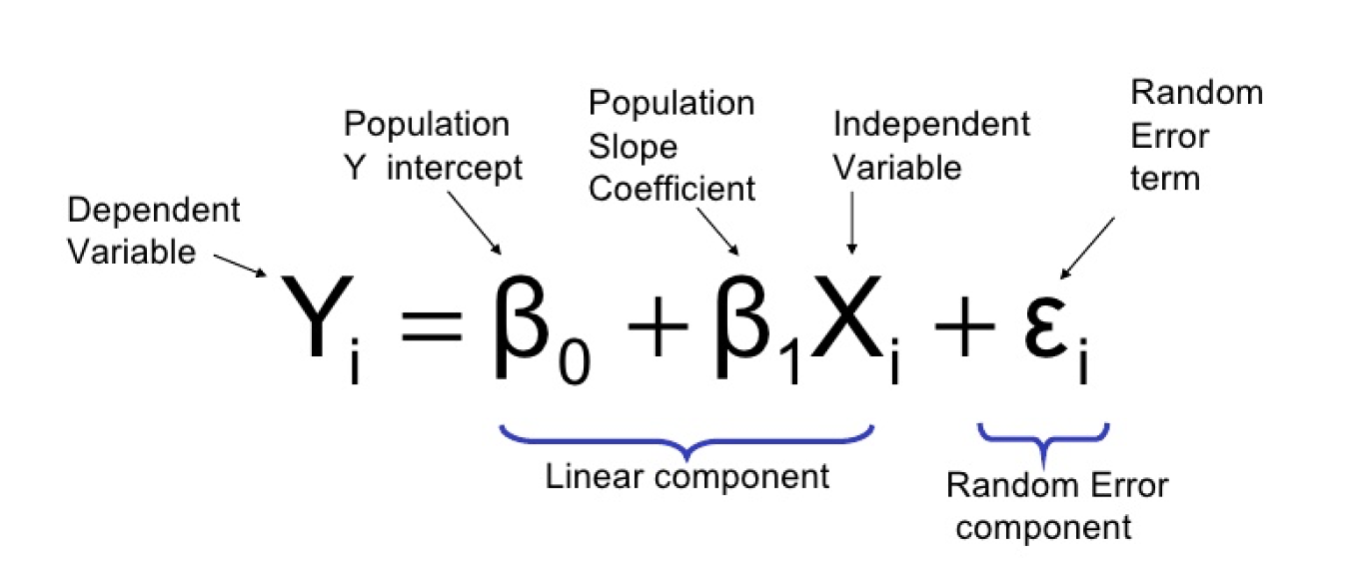
Proposed Solution for Anomaly Detection
Source: Department of Statistics, ITS
Notes:
Linear regression is well known and will be using it for anomaly detection - already know our training/testing data set for a release
Release can be daily, weekly, quarterly so on. The objective is to find the delta between new and old code (have things improved or degraded?)

Slide 8
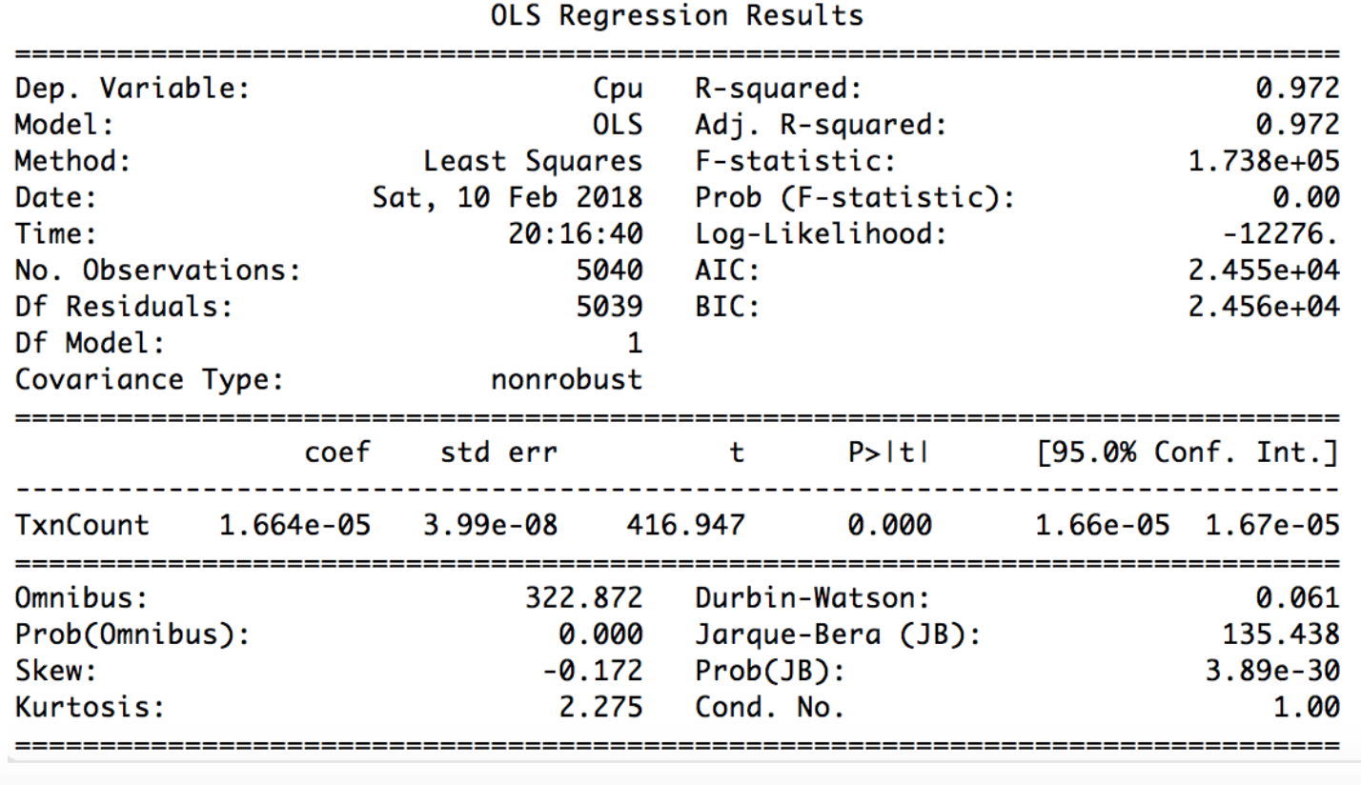
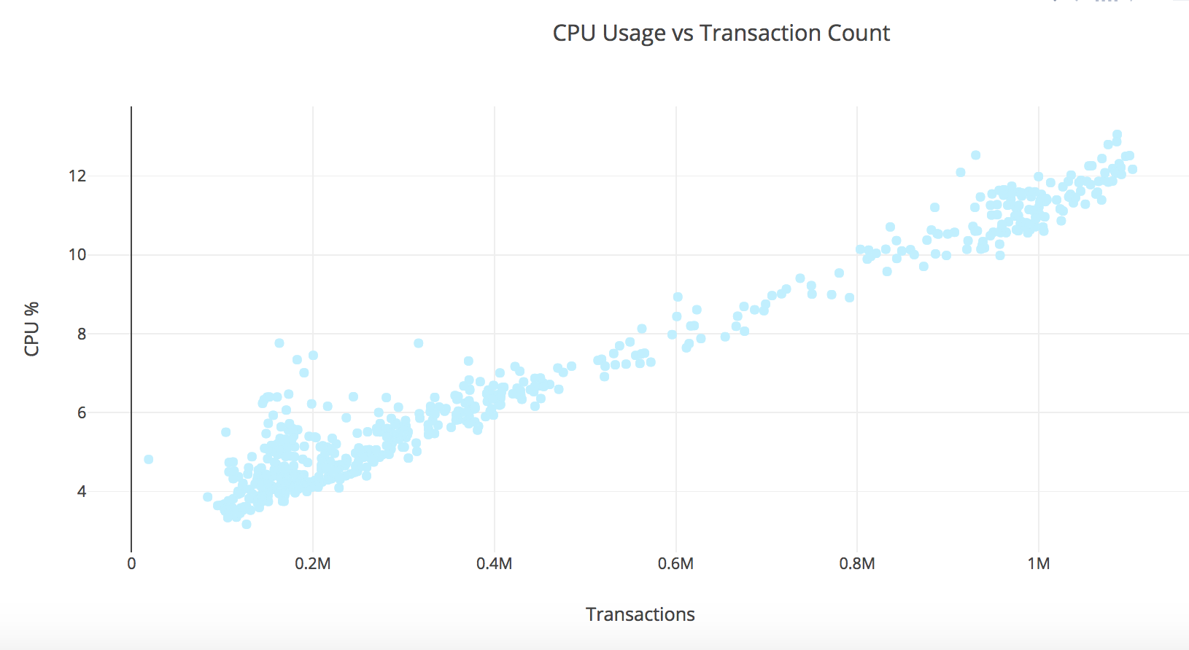
Anomaly Detection Approach - Find Distribution for “Normal”
Notes:
This is the distribution of CPU vs transactions/load on server - looks pretty linear → as transactions increase CPU usage on the pods is also increasing
If we apply the linear regression model - we get a pretty good fit

Slide 9
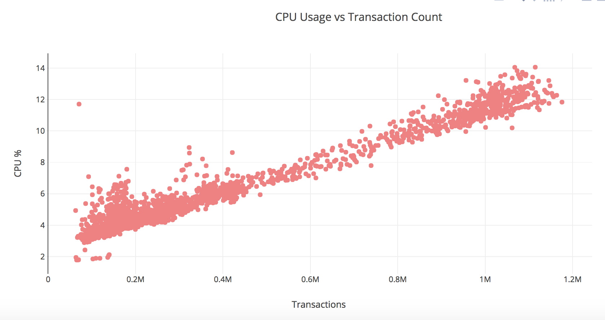
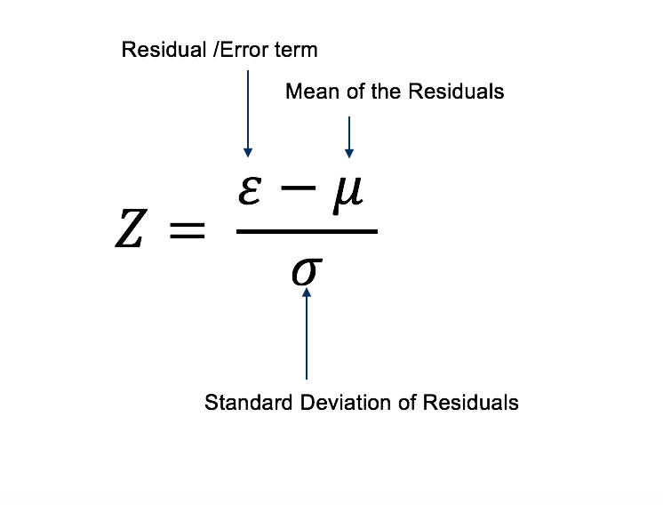
Anomaly Detection Approach - Measure Distance of a Point from Distribution
Notes:
orange line is the distribution line for the data
pick a point
Calculate distance of this point from distribution

Slide 10
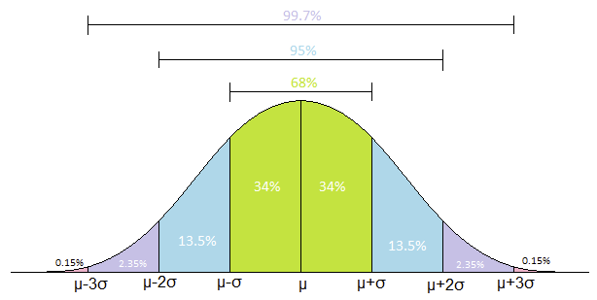
Anomaly Detection Approach - Set a Threshold
Source: Engage Education Foundation
Notes:
Use this data to set a threshold(z-score) to mark the magnitude of an anomaly or an improvement

Slide 11
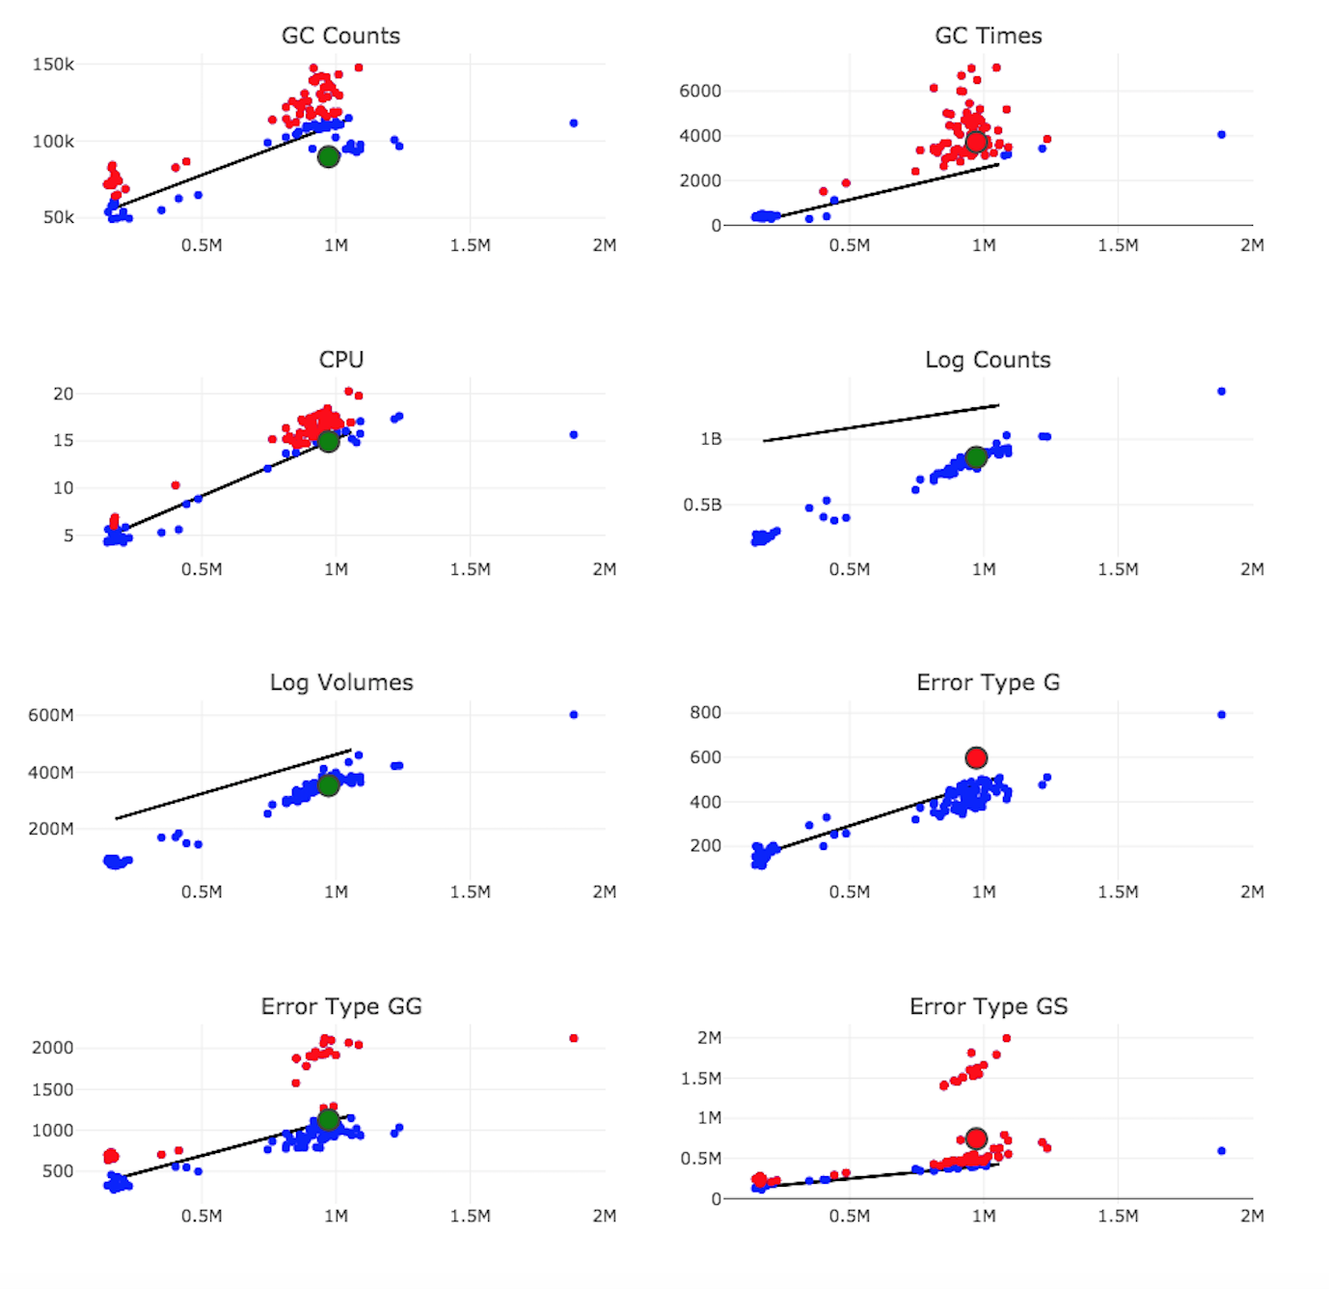
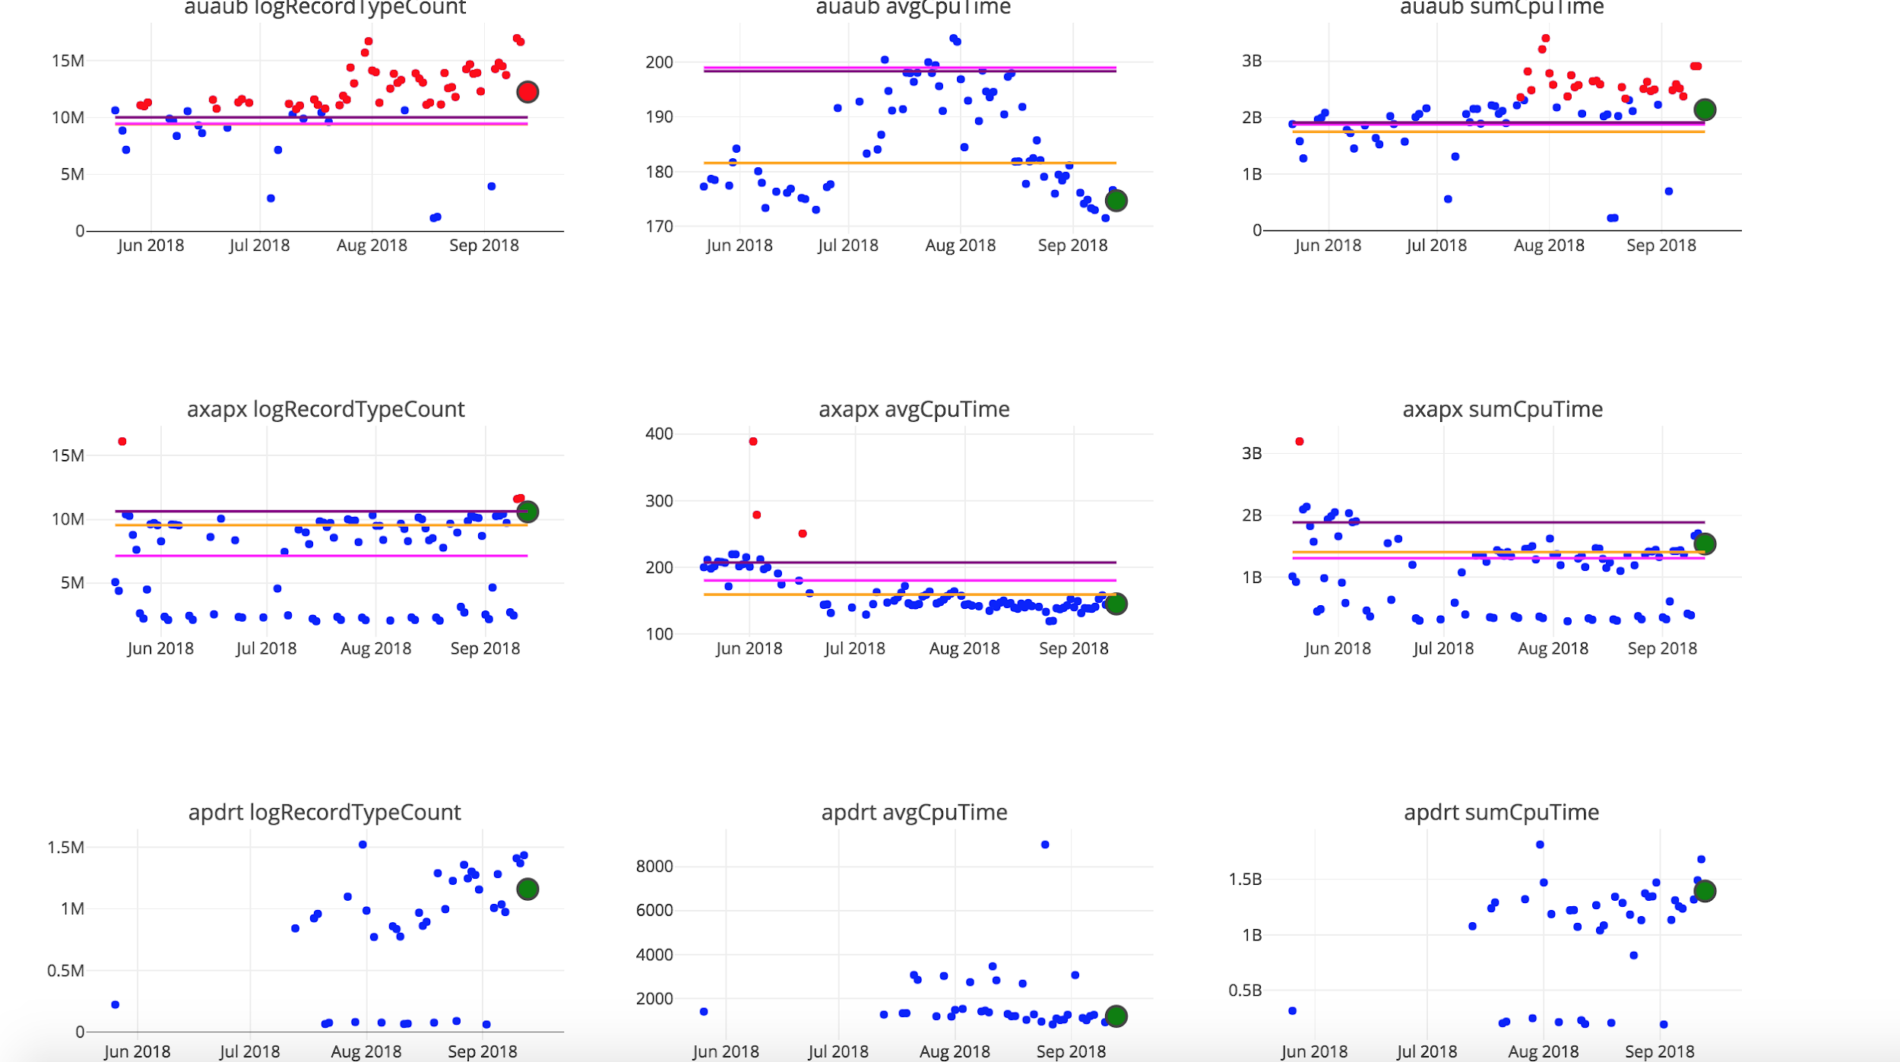
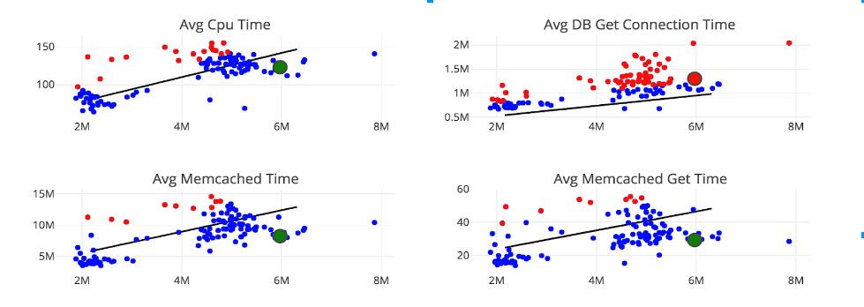
Anomaly Detection Approach in Action
Notes:
Putting these 3 steps together, you get something as shown here
Red dots marks anomalies, blue dots mark daily data which is within acceptable thresholds
Black line is the distribution of the last release (training data)
All the blue/red dots are the current release (test data)
This approach can be extended to individual transactions and also be able to identify resource intensive new transactions/features in code

Slide 12
Anomaly Detection at Scale
pod 2
pod 1
pod 4
pod 3
pod 5
Notes:
Based on the number of anomalies detected at any given point of time and the magnitude, we can prioritize the pods - which pods need to be looked at immediately.
This is helpful when you have the task to monitor 100s of pods and identify perf issues that could potentially impact customers.
Add alerts for instant notification

Slide 13
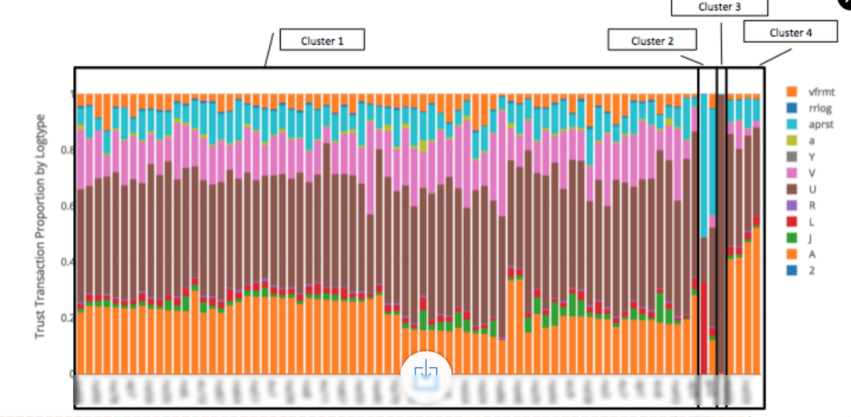
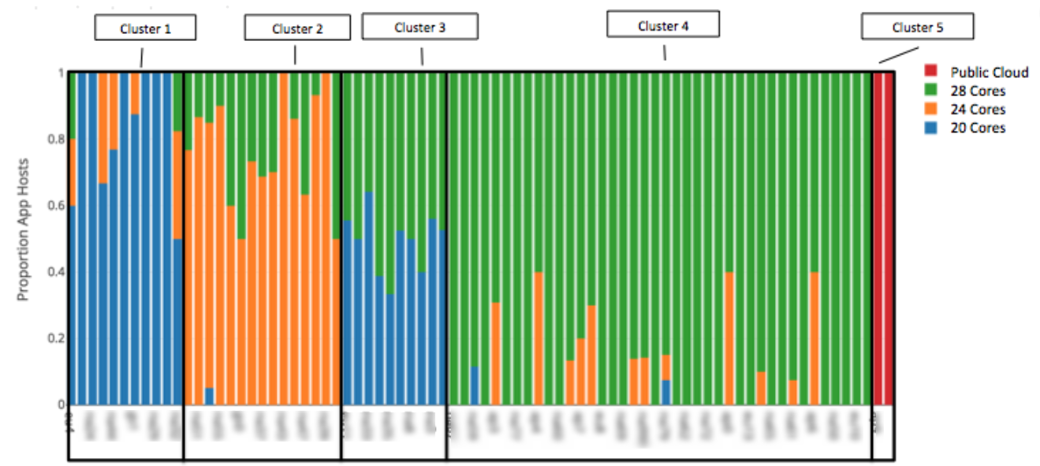
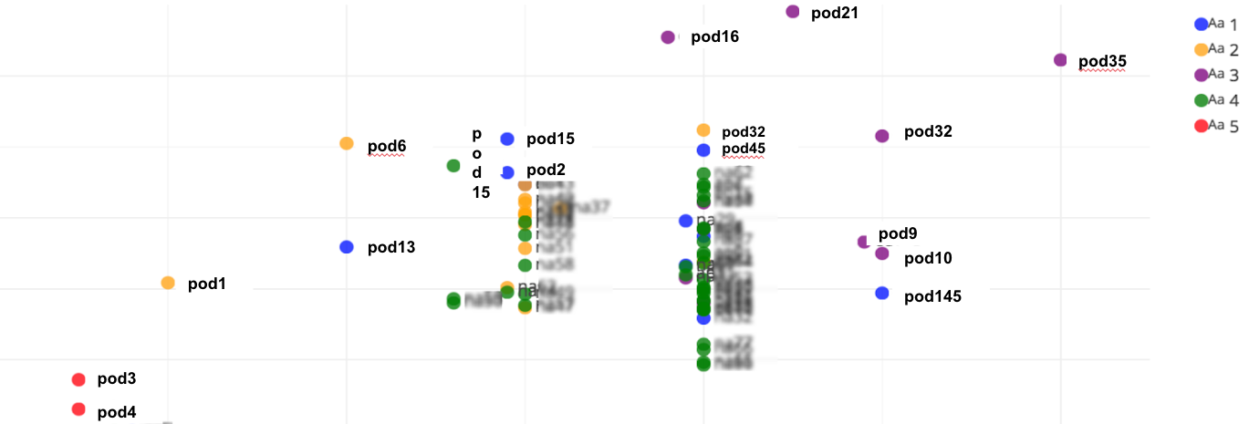
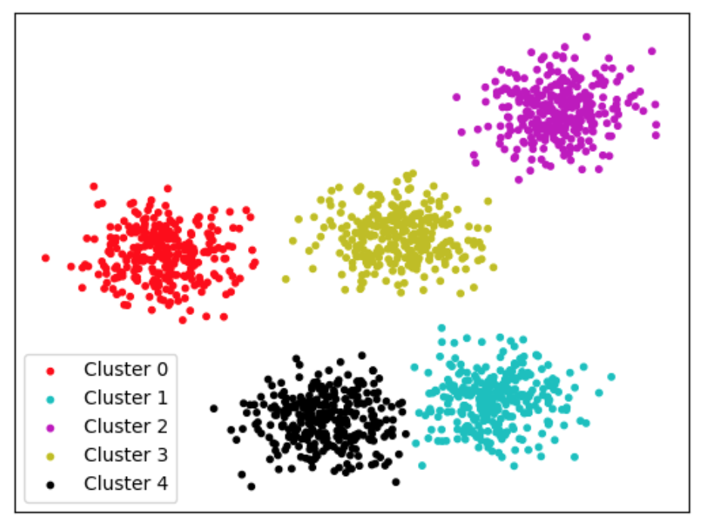
Anomaly Detection at Scale
Different Perf Profiles for Pods
Customer profile
Number of orgs
Transaction processing/min
Mix of hardware types
Age of hardware
Number of hosts
Traffic profile
Amount of async processing
Custom Objects
Org Hierarchies
Number of Users
Notes:
Another simple technique that helps with identifying which pods/customers could potentially get impacted, is by clustering pods together
Clustering can be based on multiple criteria but the end result is to proactively identify perf problems

Slide 15
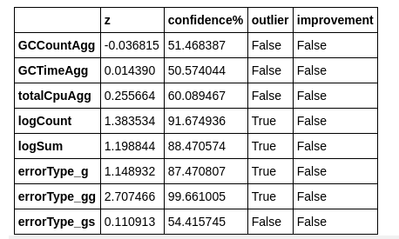
Appendix

